Slide 1
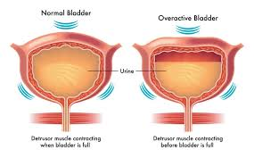
Lower urinary tract symptoms in aging women
T- eftekhar

Slide 2
Aging is a natural process, which is one of the stages of humans' growth and development.
During this process, individuals experience
physiological, mental, and social changes.
Lower urinary tract symptoms are common in women.
It is difficult to determine the prevalence due to the multifactorial etiology, and the frequency is known to increase with age .

Slide 3
. Urinary incontinence (UI) is defined as a “complaint of involuntary loss of urine” .
The prevalence of the condition increases with age, and it is reported to affect 58%–84% of elderly women.
The general prevalence is reported to be between 38 % and 55 % in women over 60 years .
. The general prevalence is reported to be between 38 % and 55 % in women over 60 years .

Slide 4
The association between baseline multimorbidity (i.e. ≥2 chronic conditions) and incident urinary incontinence was partly mediated by
polypharmacy (22.7%)
sleep problems (17.8%)
disability (14.7%).
In terms of individual chronic conditions
arthritis
heart disease
chronic lung disease
eye disease
at baseline were associated with significantly higher risk for development of urinary incontinence.

Slide 5
The physiology of the bladder and urethra involves ;
storage and voiding function indicating the varied presentations of lower urinary tract symptoms.
Storage dysfunction includes symptoms of frequency, urgency, nocturnal, urge and stress incontinence.
Voiding dysfunction may include slow stream, hesitancy, straining to void and incomplete emptying

Slide 6
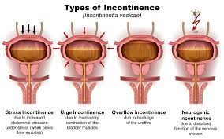

urinary incontinence in old women
Stress urinary incontinence (SUI) is defined as involuntary loss of urine with increases in abdominal pressure such as during exercise or coughing . The main etiology is a poorly functioning urethral closure mechanism and a loss of anatomic urethral support.
the maximal urethral closure pressure significantly decreased in the older women, indicating that urethral intrinsic sphincter deficiency progressed with age.
However, a lower maximal urethral closure pressure has been associated with surgical failure of a mid-urethral sling, which is the mainstay treatment for stress urinary incontinence

Slide 7

Among the elderly postmenopausal women, the pelvic muscles show loss of volume and tone.
The ligamentous and connective tissue support for the pelvic organs gradually fail because of ageing.
The weakened pelvic floor increases the risk of pelvic organ prolapse causing cystocele, rectocele and uterine prolapse.
Stage 3-4 prolapse of pelvic organs can cause UI
. A weakened pelvic floor also allows a hypermobile urethra to slide downwards during sudden increase in intra abdominal pressure

Slide 8
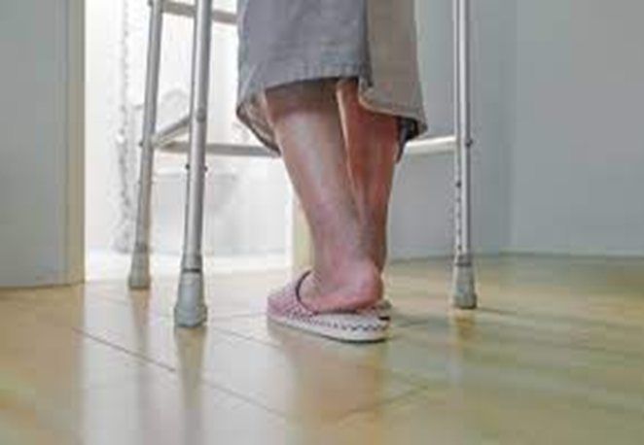
Urinary Urgency in the Elderly
Urgency: “Urgency is a lower urinary tract (storage) symptom (LUTS) defined as the complaint of a sudden compelling desire to pass urine, which is difficult to defer.
• Urgency (urinary) incontinence (UUI): Complaint of involuntary loss of urine associated with urgency.
an idiopathic condition. systemic neurologic disorders (e.g. Parkinson disease, multiple sclerosis, pelvic or spinal nerve injury).
• Overactive bladder (OAB) syndrome: Urinary urgency, usually accompanied by frequency and nocturia, with or without urgency urinary incontinence, in the absence of urinary tract infection (UTI) or other obvious pathology

Slide 9
In older adults
patients with stress urinary incontinence also had voiding dysfunction .
detrusor contractility and urinary flow rate decreased with age, particularly in women older than 60 years .
In women, voiding dysfunction may be caused by anatomical outlet obstruction or impaired detrusor contractility.
Another retrospective cohort study of women who underwent urodynamic measurements reported that 24% of the patients had bladder voiding dysfunction, and that this incidence was similar to the incidence of storage dysfunction

Slide 10
In older adults
brain tissue loss, protein dysregulation, and degeneration/demyelination directly contribute to LUTS.
Further evidence can be found in neurodegenerative conditions:
multiple sclerosis (Ramasamy and Smith, 2021)
Alzheimer’s disease (Lee et al., 2014)
Parkinson’s disease (Campeau et al., 2011) all have associated LUTS.

Slide 11
The prevalence rates of SUI, UUI and MUI in developed countries are 12.6 %, 5.3 % and 9.1 %.
The prevalence of overactive bladder in women increases with age, from 2% up to 53 %, and has been estimated to be 19.1 % for women over 65 years of age .

Slide 12
Neurogenic: Proposed by suggesting that subclinical neurological changes (either sensitization of afferents to the bladder or diminished central inhibition) produce detrusor overactive
• Urethrogenic: Proposes that urethral instability (sudden loss of urethral pressure during filling) and/or
loss of the tonic inhibitory effect of the urethral sphincter is the cause of bladder overactivity .
This idea is supported by observations that women with bladder overactivity have lower urethral muscle mass than age matched controls and that urethral muscle density declines with aging

Slide 13
Conditions associated with urinary urgency and UUI
–
Diabetes
– Obesity
– Metabolic syndrome
– Multiple sclerosis
– Parkinson’s disease
– Stroke
– Spinal injury
– Depression
– Hypertension
– Irritable bowel syndrome
– Fecal impaction
– Pelvic surgery
– Spinal surgery

Slide 14
Potential risk factors such as
age, race, heredity,
Obesity
hypertension, diabetes, constipation, smoking
history of corticosteroids use
respiratory diseases
menopause, anatomical structure of the female urethra
multiple pregnancies and vaginal deliveries
history of hysterectomy have been reported to cause urinary incontinence in older women

Slide 15
Established urinary incontinence When the duration of UI is over 4 weeks and there are often abnormalities of the lower urinary tract. There are 4 types under this category:
detrusor over-activity
stress incontinence
bladder outlet obstruction
detrusor underactivity.
In some patients, it may be a combination of more than one type, called mixed incontinence

Slide 16
Variants of detrusor over-activity include
concomitant
detrusor hypocontractility present in half of the subjects with detrusor over-activity .
This condition is called Detrusor Hyperactivity with Impaired Contractility (DHIC).
DHIC is associated with a high Post-Void Residual Volume (PVRU).
urethral resistance, rather than cortical abnormalities.
Clinically, DHIC is problematic because treatment with anticholinergic agents for detrusor over-activity is contraindicated in the presence of high PVRU m

Slide 17
Menopause and aging are strongly associated with the emergence or worsening of lower urinary tract dysfunction .
The lower urinary tract shares embryological origins with the female reproductive system and it is thus sensitive to the effects of steroid hormones .
Sex steroid hormones have an important role in the regulation of lower urinary tract function
estrogen, androgen and progesterone receptors are expressed throughout the lower urinary tract
directly related to urinary continence such as the urethra, the vagina and the pelvic floor muscles, fascia and ligament

Slide 18
A recent study on the composition of the vaginal microbiota in pre-, peri- and postmenopausal women found significant associations between vaginal bacterial composition with both menopause stage and signs of vaginal atrophy .
whether sex hormones affect the urobiome in the same manner as the vaginal microbiome needs further investigation.

Slide 19
. An intact cognition is important to perceive the sensation of bladder fullness with the ability to postpone micturition
after the first sensation, motivation and desire to pass urine, sufficient mobility and coordination to reach the toilet with hand dexterity to manipulate clothing items in order to do so

Slide 20
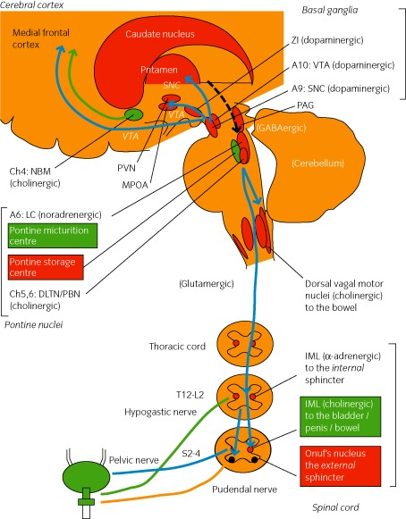
Central control of detrusor activities includes the frontal cortex, basal ganglia, Pontine Micturition Centre.
The central control provides an inhibitory input on the detrusor to reduce contractions during the bladder filling phase.
Dementia, particularly vascular dementia, normal pressure hydrocephalus, Frontotemporal lobe dementia, Alzheimer’s Disease (AD) present with features of detrusor over-activity where urgency is the main symptom

Slide 21
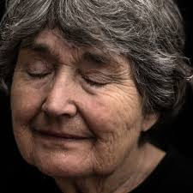
Incontinence in a person with dementia increases the level of dependency and results in a heavier care burden.
Many clinicians believe that people with dementia will automatically have urinary incontinence because of cortical dysfunction.
A number of studies in this population group have shown that impaired mobility and the inability to transfer are greater predictors of urinary incontinence than the severity of the dementia

Slide 22
ischemia-induced detrusor overactivity exist.
The increasing prevalence of OAB with age could be due to the associated increase in atherosclerotic disease.
Mucosa: In the past the bladder epithelium was viewed as a simple barrier. A great deal of research in the past decade has elucidated relevant epithelial physiological and sensory functions that could have important impacts on bladder function, including producing detrusor over activity.
– detrusor hypertrophy, collagen deposition, decreasing bladder wall compliance, and acquired neurogenic changes

Slide 23
Other causes of bladder outlet obstruction include;
strictures of the urethra
rare neoplasms of the urethra,
stones or foreign body, or
neurogenic disease promoting detrusor sphincter dyssynergia.

Slide 24
. Arthritis may also limit the ability to use position changes to prevent stress-incontinent episodes.
. Treatment for some forms of arthritis may trigger detrusor overactivity and cause incontinence
(NSAID) having an adverse impact on bladder .

Slide 25
Management of constipation is an integral part of the initial management of urinary incontinence and, as such, is necessary for the primary level clinician to consider.
However, management of faecal incontinence and stool impaction requires more specific knowledge and skills
There are close links between bladder and bowel health.

Slide 26
The relationship of incontinence and back pain may be due to the contribution of trunk muscles to continence and lumbo pelvic control, especially in younger).
An association between incontinence and back pain for a cohort of 70-75 year olds has also been demonstrated in the Australian Longitudinal Study on Women’s Health (MD. Smith, Russell, & Hodges, 2006)

Slide 27
Ageing changes the diurnal pattern of fluid excretion due to
reduced renal concentrating capacity
increased sodium excretion in the urine
a loss of the daily rhythm of antidiuretic hormone secretion.
This causes larger volumes to be excreted at night (nocturnal polyuria), increases the likelihood of nocturnal enuresis.
Cardiac dysfunction also leads to increased sodium excretion, and, when heart failure is present, fluid is retained in the extravascular spaces, as hyponatremia reduces fluids being drawn into the blood vessels.
At rest, improved cardiac output improves venous return to the heart, which in turn increases blood supply to the kidneys, resulting in an increase in urine production

Slide 30
Dehydration risks in the elderly include:
• Age > 85 years
• Thirst reduction
• Mobility and dexterity problems, causing difficulty accessing drinks • Communication problems
• Cognitive disorders
• Swallowing difficulties
• Reduced appetite
• Medications (diuretics, laxatives, sedatives)
• Acute pathology (fever, vomiting, diarrhoea)
• Lack of attention from caregivers
• Fluid loss due to perspiration.

Slide 32
In the review of systems
hormonal status, sexual functioning
neurosensory changes
gastrointestinal function
bowel habits are assessed.
Bowel function is strongly correlated with urinary symptoms and must also be taken into account when formulating a treatment strategy.
A list of medications should not only include dosages, but should be documented as a time line so as to explore commonly associated pharmacological causes of urinary adverse effects

Slide 33
Physical Examination
observing the patient’s ability to transfer and ambulate.
Functional limitations are an important contributor to the severity of OAB.
Neurological evaluation.
a catheter or ultrasound can be used to confirm adequate bladder emptying when clinically indicated.
standard abdominal examination
the pelvic floor is evaluated.
Inspection for signs of urinary and/or fecal incontinence
: integrity of the perineal skin, intragluteal folds, perianal health.
estrogen status would be determined.
inspection, sensory testing of the saddle region is carried out

Slide 34
Pelvic floor tone
digital vaginal and/ or rectal examination (high, normal, or low/absent).
pelvic floor muscles is tested by asking the patient to contract the sphincter and relaxed
voiding dysfunctions.

Slide 35
A written voiding diary can provide information about potential modifiable factors associated with incontinence episodes.
Urinalysis should be used to identify urinary tract infections, glycosuria or hematuria that may be associated with urinary incontinence.
Potential reversible causes should be assessed and treated.
These include ;
urinary tract infections
excessive fluid intake
medications that may worsen UI
(such as diuretics, alpha blockers, ACE inhibitors)

Slide 36
A written voiding diary can provide information about potential modifiable factors associated with incontinence episodes.
Post-void urinary residue assessment is recommended when pelvic organ prolapse is present or when the patient reports the sensation of incomplete or unsatisfactory voiding.
Assessment of bladder emptying by measuring post-void residual volume is also recommended when SUI surgery is planned: up to one-third of total voided volume is considered normal

Slide 37
the main reasons for specialist referral
The presence of hematuria
Pain
recurrent urinary tract infections
previous oncological or pelvic floor reconstructive surgery radiotherapy
constant leakage suggesting fistula and detection of clinically relevant voiding dysfunctions

Slide 38
Other reversible comorbidities such as obesity, constipation and depression should be evaluated and treated.
However, the presence of any of these conditions should not be considered a reason to postpone or avoid incontinence treatment.
Pelvic examination should assess the presence of vulvovaginal atrophy (VVA), pelvic floor muscle abnormality and pelvic organ prolapse.
Pelvic floor muscle integrity and function should be evaluated to identify women who are unable to correctly contract their pelvic floor muscles.
These patients can benefit from supervised pelvic floor muscle training.

Slide 39
Conservative interventions include
lifestyle interventions
behavioral therapies
including bladder training
physical therapies such as pelvic floor muscle training with or without biofeedback
electrical or magnetic stimulation and voiding pattern modification.

Slide 40
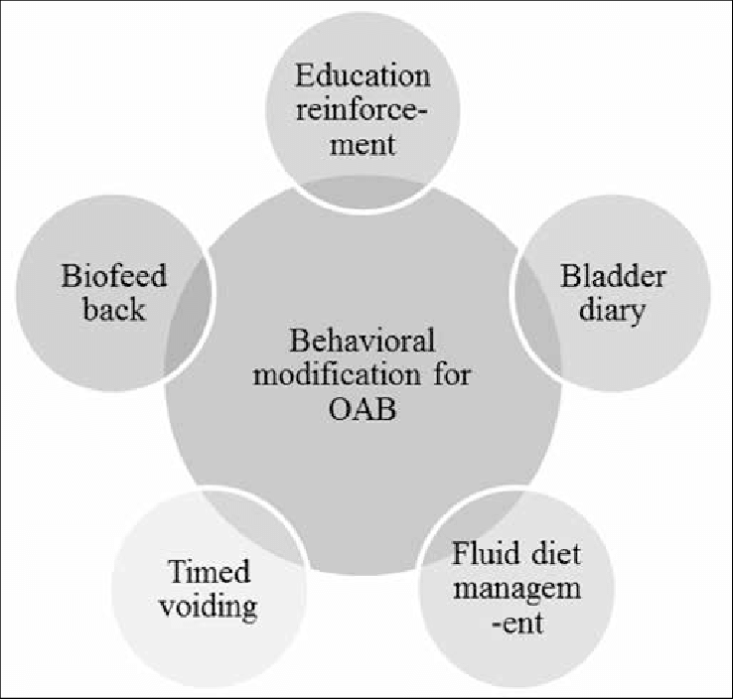

Slide 41
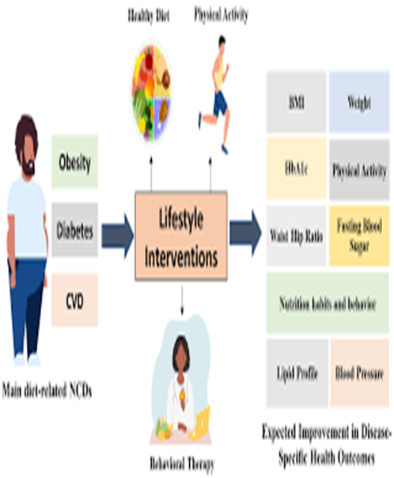
1. Lifestyle interventions and behavioral therapies Initial management of urinary incontinence can begin with a noninvasive approach.
Lifestyle modifications include smoking cessation
weight loss, management of constipation
timed voiding during the day, fluid intake management, and reduction in consumption of caffeine and alcohol .
Timed voiding and fluid restriction are effective first-line strategies, especially for women with UUI

Slide 42
a noninvasive approach. Lifestyle modifications include smoking cessation, weight loss
management of constipation, timed voiding during the day, fluid intake management, and reduction in consumption of caffeine and alcohol .
Timed voiding and fluid restriction are effective first-line strategies, especially for women with UUI

Slide 43
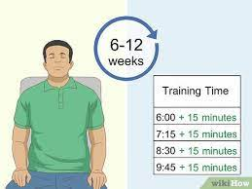
Bladder training consists of patient education aimed at correcting frequent urination
improving bladder control,
prolonging voiding intervals, increasing bladder capacity
reducing the number of incontinence episodes, an
ultimately regaining confidence in controlling bladder function.
Bladder training aiming to decrease voiding frequency to every two to three hours is useful in women with UUI or MUI; however, its effectiveness diminishes after treatment cessation

Slide 44
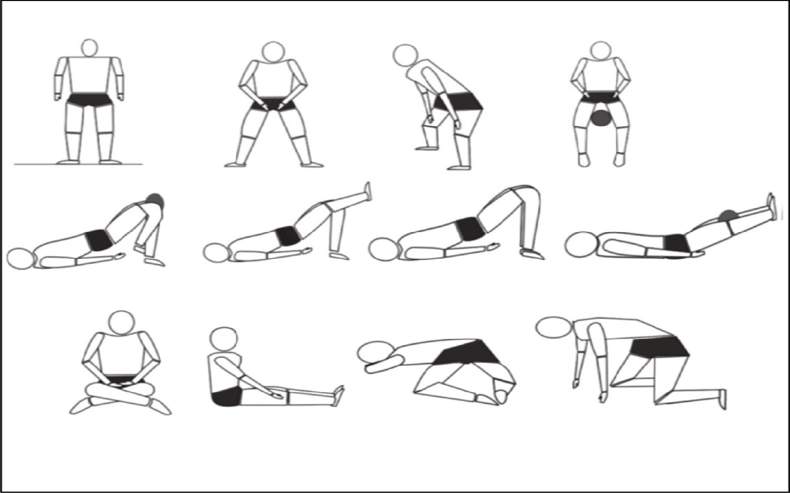
Pelvic floor muscle training

Slide 45

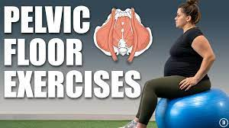
Pelvic floor muscle training is a supervised treatment that involves exercises to increase awareness of and strengthen the pelvic floor muscles.
The main aim is to improve pelvic floor muscle function in terms of strength, endurance and co-ordination.
Through pelvic floor muscle training, a woman can improve muscular support of the bladder neck and the proximal urethra before and during an increase in intra-abdominal pressure, thus preventing stress-associated urine leakage .
In the context of UUI, pelvic floor muscle training can provide the ability to inhibit detrusor contractions by repeated and conscious muscle contractions .
However, the timing, number, intensity and duration of pelvic floor muscle contractions considered sufficient to reduce detrusor contraction are undetermined

Slide 46
Sacral neuromodulation is an outpatient surgical procedure in which sacral nerve stimulation occurs through electrodes placed in the S3 foramen.
When a short-term test has proved the treatment to be effective for the individual, a permanent external stimulator can be implanted. After implantation, approximately 60%–90% of women report improvement and 30%–50% report cure

Slide 47
success rates of 54–93 %
low rates of transient local adverse events and efficacy similar to that of anticholinergic medications .
At present, the literature suggests that the main mechanism of action of neuromodulation is the plastic reorganization of the cortical network triggered by peripheral neurostimulation .
All these treatments are effective for selected patients and should be offered to postmenopausal women with UUI that is refractory to behavioral and pharmacological therapy.

Slide 48
Antimuscarinic agents: oxybutynin (Ditropan), tolterodine (Detrol), solifenacin (Vesicare), propiverine (not available in United States)
Discontinuation because of adverse effects such as dry mouth, constipation, blurred vision or fatigue is frequent.
Contraindications to anticholinergic medications include untreated narrow-angle glaucoma and cardiac arrhythmias.
A recent longitudinal cohort study showed a risk of deterioration in cognitive function and brain atrophy with prolonged use of anticholinergics, particularly in the elderly

Slide 49
A beta-3 adrenergic agonist (mirabegron) is also available.
Stimulation of beta-3 adrenergic receptors stimulates relaxation of bladder smooth muscle, with a consequent increase in urine storage capacity.
Mirabegron has resulted in a significant reduction of UUI episodes compared with placebo in several trials .
The most common adverse events of mirabegron are hypertension, nasopharyngitis and urinary tract infection.
In general, the cardiovascular safety of mirabegron is comparable with that of anticholinergics.
However, mirabegron should be not offered to patients with uncontrolled hypertension.

Slide 50
Treatment of refractory UUI and overactive bladder.
There are 3 FDA-approved treatments for women with persistent urgency incontinence symptoms or intolerance to medications.
Onabotulinum toxin A (onabotA, 100 UI) blocks the presynaptic release of acetylcholine, thus decreasing muscarinic receptor activation and detrusor contraction.
The drug is injected into the bladder through a cystoscope with local anesthetic in an office setting. Onabotulinum toxin A has been licensed in Europe to treat overactive bladder with persistent or refractory UUI since 2011.
Treatment is effective in approximately 65 % of patients for approximately 6–12 months

Slide 51
Posterior tibial nerve stimulation is an office procedure consisting of 12 weekly 30-minute sessions.
A small acupuncture needle is placed posterior and superior to the medial malleolus to stimulate the posterior tibial nerve peripherally and to modulate the sacral nerve plexus through the S2-S4 nerves.
The exact mechanism of action of posterior tibial nerve stimulation on bladder function is unclear but it is likely mediated through the retrograde stimulation of the sacral nerve plexus.

Slide 52
. Laser energy has been proposed for the management of mild to moderate SUI.
the cure rate of SUI after a laser procedure was reported to be between 62 % and 78 %.
despite the short-term data suggesting a beneficial effect, there is still insufficient evidence to offer it as an alternative over the gold standard approaches (pelvic floor muscle training, midurethral slings)

Slide 53
Pathophysiology of nocturia in the elderly
Nocturnal polyuria Low levels of antidiuretic hormone at night
Altered circadian rhythm in plasma vasopressin levels Increased sodium excretion at night
Decreased nocturnal bladder capacity
Comorbid conditions (diabetes mellitus, Increased irritative symptoms
Overactive bladder Age-related
changes Decreased functional bladder capacity Decreased maximum urinary flow rate Decreased ability to postpone urination Increase in postvoid residual volume Diminished bladder compliance Detrusor overactivity Decreased renal ability to concentrate urine
Others Increase in nighttime plasma natriuretic peptide Increase in blood pressure Increase in nighttime catecholamine levels Decrease in plasma melatonin levels Mobilization of edema fluid Autonomic dysfunction

Slide 54
Risk factors for nocturia Older age Obesity
Nocturnal eating and poor daytime appetite Obstructive sleep apnea Depression Frequent napping
Congestive heart failure
Diabetes mellitus Spinal stenosis
Recurrent cystitis
Lung disease Drugs:
cholinesterase inhibitors, beta-blockers, calcium channel blockers, antihistamine

Slide 55
Management strategies for nocturia
General approach Address underlying causes:
treat diabetes mellitus, diabetes insipidus, infections; correct metabolic disorders
Survey the patient’s medications Refer to specialists (eg, a pulmonologist for obstructive sleep apnea, a urologist for benign prostatic hyperplasia)
Nonpharmacologic measures
Avoiding nighttime fluid intake, including alcohol and caffeine Compression stockings Leg elevation during the afternoon
Continuous positive airway pressure for obstructive sleep apnea Moderate exercise Reducing nonsleep time in bed Sleeping in a warm bed Phototherapy

Slide 56
Pharmacologic therapies
Desmopressin (DDAVP)
Antimuscarinic agents: oxybutynin (Ditropan), tolterodine (Detrol), solifenacin (Vesicare), propiverine (not available in United States)
Diuretics: hydrochlorothiazide, furosemide (Lasix) Cyclo-oxygenase-2 inhibitors: celecoxib (Celebrex) Other nonsteroidal anti-inflammatory drugs: diclofenac (Voltaren), loxoprofen (not available in United States) Botulinum toxi

Slide 57
• Tight control of blood sugar for patients with diabetes mellitus
• Treatment of diabetes insipidus
• Referral for patients with primary polydipsia
• Management of hypercalcemia and hypokalemia
• A survey of medications
• Treatment of infections.

Slide 58

ممنون از توجه شما

